Slide 1

Reducing Hospital Readmissions with Responsible AI
Presenter: John Raffy Raymundo

Slide 2
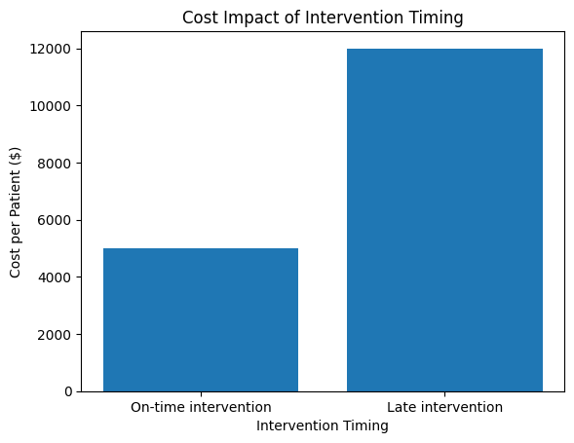
The Business Problem
Unplanned Readmissions Are Costly and Avoidable
Readmissions drive financial penalties
Late identification limits preventive care
Current approaches are reactive

Slide 3

Why This Matters to the Business?
Readmissions Impact Cost, Capacity, and Reputation
Key message
Increased bed occupancy
Staff workload inefficiencies
Patient satisfaction risk

Slide 4
Early Risk Identification Enables Proactive Care
Predict risk before discharge
Enable targeted follow-ups
Reduce avoidable readmissions

Slide 5
Predictive Model Supporting Clinical Decisions
Uses existing patient data
Produces a risk score at discharge
Supports — not replaces — clinicians

Slide 6
Recall Prioritized to Minimize Missed High-Risk Patients
Missing a high-risk patient has high clinical cost
Model intentionally prioritises recall
Accepts manageable false positives

Slide 7
What This Enables
Area | Current | With AI
Risk identification | Late | Early
Intervention | Reactive | Proactive
Resource use | Broad | Targeted

Slide 8

Designed for Trust and Governance
Explainability considered
Bias and fairness assessed
Human-in-the-loop approach

Slide 9

Clear Path to Value
Low-risk phased rollout
Clinical validation first
Continuous monitoring

Slide 10
AI Enables Safer, Earlier, and More Efficient Care
Strong alignment with clinical and financial goals
1
Conservative, safety-first design
2
Ready for pilot deployment
3

Slide 11
Thank you for listening
Link to GitHub:
Github link: Predicting 30-Day Hospital Readmissions Using Machine Learning

